Slide 1
Introduction to Robotics
Dr Mark Zarb (RGU)
Dr Miachel Scott (Falmouth University)

Slide 2
Learning Objectives
Over the next few weeks, you will work in teams to build and code a robot from scratch.

Slide 3
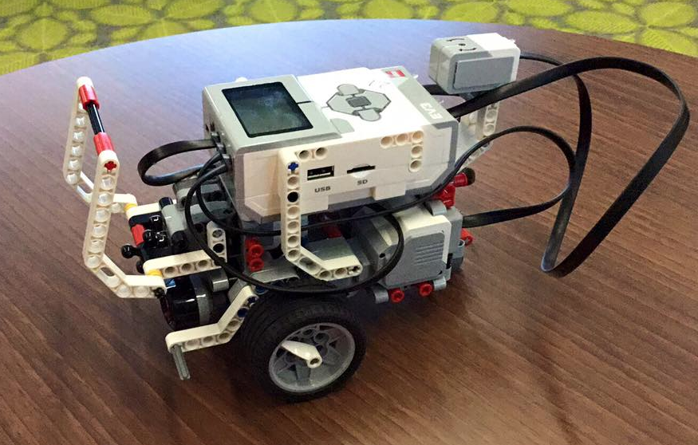
Meet your Robot

Slide 4
Meet your Robot
You are responsible for everything – from building to coding.
You will be working and competing in teams.
Split into teams.

Slide 5
Schedule
(Basic schedule of work here, showing supervised and unsupervised sessions.)
You are only allowed access to your robot at these times, so plan accordingly!
week | Tuesday (supervised) | Thursday (unsupervised)
1 | LEGO 1 | Study Skills
2 | LEGO 2 | Study Skills
3 | LEGO 3 | Study Skills
4 | LEGO 4 | ?

Slide 6
Start Building!
On Moodle (see CM1013), you should find a list of instructions that will allow you to build your robot, as well as a detailed description of the task you need to undertake.
TODAY, you should aim to build a base robot by following the instructions in build_base robot.pdf.
If you need more time, you can work on this on Thursday. It is imperative that you complete the first stage robot by then!

Slide 7
Parts
% A document class for assignment briefs for BSc Computing for Games at Falmouth University
 | % Based on the article class
 | \LoadClass[a4paper]{article}
 | % Load required packages
 | \usepackage{tikz} % For fancy graphics and positioning
 | \usepackage{xcolor} % For colours
 | \usepackage{environ} % Required for NewEnviron definitions in this file
 | \usepackage{pdflscape} % For landscape pages
 | \usepackage{longtable} % For >1 page marking rubric
 | \usepackage{colortbl} % For colouring table cells
 | \usepackage{microtype} % For improved hyphenation
 | \usepackage{calc}
 | % Adjust margins
 | \usepackage[margin=1.5cm, left=6.5cm]{geometry}
 | \setlength{\marginparwidth}{4.5cm}
 | \setlength{\marginparsep}{0.5cm}
 | % Disable page numbers
 | \pagestyle{empty}
 | % Set the font
 | \usepackage{avant}
 | \renewcommand{\familydefault}{\sfdefault}
 | % Put margin notes on the left hand side
 | \reversemarginpar
 | % Add spacing between paragraphs, and no indentation
 | \setlength{\parindent}{0em}
 | \setlength{\parskip}{1em}
 | % Adjust section title spacing
 | \usepackage{titlesec}
 | \titlespacing{\section}{0cm}{\parskip}{0cm}
 | \titlespacing{\subsection}{0cm}{\parskip}{0cm}
 | % Allow document version to be specified, e.g. \version{1.1} in the preamble
 | % Defaults to 1.0 if not specified
 | \newcommand{\@version}{1.0}
 | \newcommand{\version}[1]{\renewcommand{\@version}{#1}}
 | % Custom maketitle command, using tikz for fancy layout
 | \renewcommand{\maketitle}{%
 | \begin{tikzpicture}[remember picture, overlay]
 | \node[anchor=north west, xshift=1cm, yshift=-1cm] (banner) at (current page.north west) {
 | \includegraphics[width=19cm]{header}
 | };
 | \node[anchor=north east, xshift=-0.5cm, yshift=-0.5cm] at (banner.north east) {
 | \parbox[t]{18cm}{\raggedleft\Huge\color{white}{\MakeUppercase{\@title}}}
 | };
 | \node[anchor=south east, xshift=-0.5cm, yshift=0.5cm] at (banner.south east) {
 | \parbox[t]{18cm}{\raggedleft\color{white}{Version \@version\\BSc Computing for Games}}
 | };
 | \node[anchor=north west] at (banner.south west) {
 | \parbox[t]{18cm}{\raggedright\color{gray}{\@author}}
 | };
 | \end{tikzpicture}
 | \vspace{4cm}
 | }
 | % Inspirational quote in the margin
 | \newcommand{\marginquoterule}{{\color{black}\rule{4.5cm}{1pt}}}
 | \NewEnviron{marginquote}{%
 | \begin{tikzpicture}[remember picture, overlay]
 | \node[anchor=west, xshift=1.5cm] at (current page.west) {
 | \parbox[t]{4.5cm}{%
 | \setlength{\parskip}{1em}%
 | \marginquoterule\par%
 | \small\centering\emph{\color{blue!50!black}\BODY}\par%
 | \marginquoterule%
 | }
 | };
 | \end{tikzpicture}
 | }
 | % Inspirational image in the margin
 | % First parameter is the image file name, second parameter is the caption
 | \newcommand{\marginpicture}[2]{%
 | \begin{tikzpicture}[remember picture, overlay]
 | \node[anchor=south west, xshift=1.5cm, yshift=1.5cm] at (current page.south west) {
 | \parbox[t]{4.5cm}{%
 | \includegraphics[width=4.5cm]{#1}\par
 | {\footnotesize #2}
 | }
 | };
 | \end{tikzpicture}
 | }
 | % Marking rubric
 | \newenvironment{markingrubric}{%
 | \clearpage
 | \newgeometry{margin=1cm}
 | \begin{landscape}
 | \section*{Marking Rubric}
 | \begingroup\scriptsize
 | \setlength{\extrarowheight}{2pt}
 | \begin{longtable}{|p{2.5cm}|p{1.5cm}|*{6}{p{3.4cm}|}}
 | \hline
 | \centering \textbf{\small Criterion} &
 | \centering \textbf{\small Weight} &
 | \centering \cellcolor{gray!50} \textbf{\small Refer for Resubmission} &
 | \centering \textbf{\small Basic Competency} &
 | \centering \textbf{\small Basic Proficiency} &
 | \centering \textbf{\small Novice Competency} &
 | \centering \textbf{\small Novice Proficiency} &
 | \centering \textbf{\small Professional Competency} \endhead\hline
 | }{
 | \tabularnewline\hline
 | \end{longtable}
 | \endgroup
 | \end{landscape}
 | }
 | % Commands inside the marking rubric
 | % Use firstcriterion for the first criterion, and criterion for subsequent ones
 | % The difference is that firstcriterion doesn't start a new table row, because \endhead did that already
 | \newcommand{\firstcriterion}[2]{\setlength{\parskip}{0.5em}\raggedright #1 & \centering #2}
 | \newcommand{\criterion}[2]{\tabularnewline\hline\setlength{\parskip}{0.5em}\raggedright #1 & \centering #2}
 | \newcommand{\grade}{ & \setlength{\parskip}{0.5em}\raggedright}
 | \newcommand{\fail}{\cellcolor{gray!50}}
 | \newcommand{\gradespan}[2]{& \multicolumn{#1}{p{3.4cm * #1 + (\tabcolsep * 2 + \arrayrulewidth) * (#1 - 1)}|}%
 | {\setlength{\parskip}{0.5em}\raggedright #2}}
To build the base robot, you need to collect parts which you will keep for the next 4 weeks.
You can only collect parts and robots during the timetabled CM1013 slots.
Please only take what you require, and keep the part boxes organised.
You will be responsible for disassembly later this semester – the more organized you are, the easier this will be!

Slide 8
Most Importantly
Have fun!

